Slide 1

Solving the Murder of Roland Greene
A Data-Driven Forensic Investigation
Presented by : TEAM B
Date : Saturday, 4th October 2025
Time : 8:30pm WAT

Slide 2
Project Overview
Case Summary: Roland Greene, a renowned art collector, was found dead in the Vault Room of his estate at 8:00 PM, shortly after receiving a call at 7:55 PM. All 30 guests claimed to have alibis—but only one is lying.
Project Goal: Use digital evidence and SQL analysis to identify the killer by uncovering inconsistencies in movement, access, and communication.
Tools Used:
SQL for querying structured datasets
Skills Demonstrated:
Data analysis & cross-referencing
Logical reasoning & timeline validation
Forensic investigation using structured datasets

Slide 3
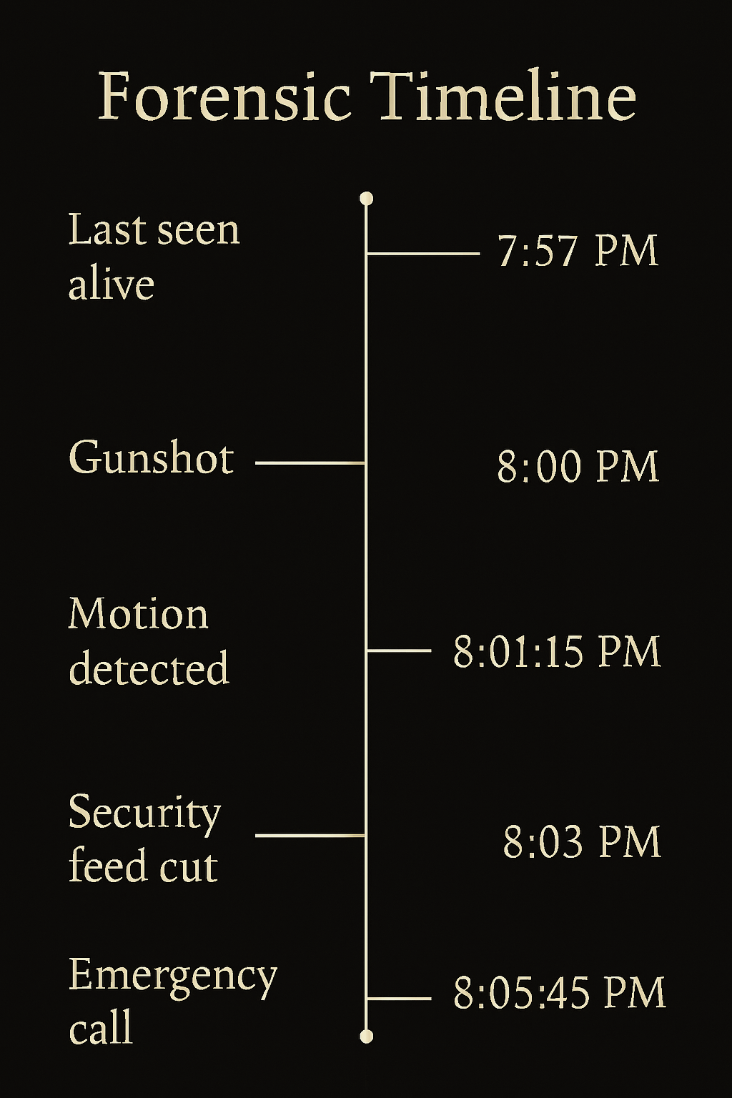

Slide 4

Investigation Objectives
Analyze suspect behavior using door logs, call history, and forensic evidence
Detect timing conflicts or access anomalies to isolate the killer
Use a forensic timeline to validate or refute alibis
Summarize the investigation process and present a data-backed conclusion
Visualize key timelines or events to support your claims

Slide 5
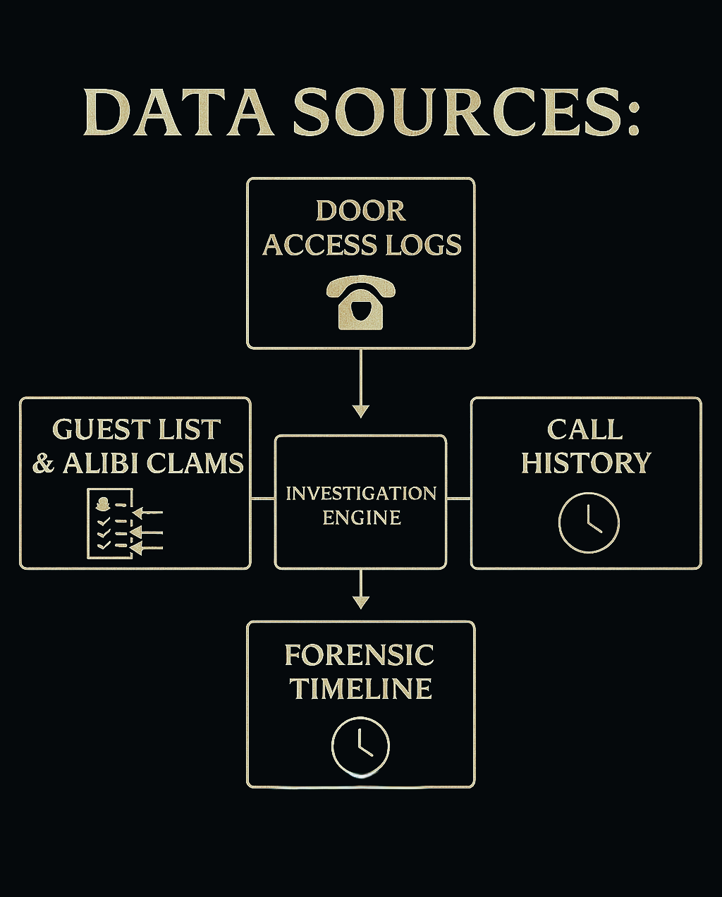

Slide 6
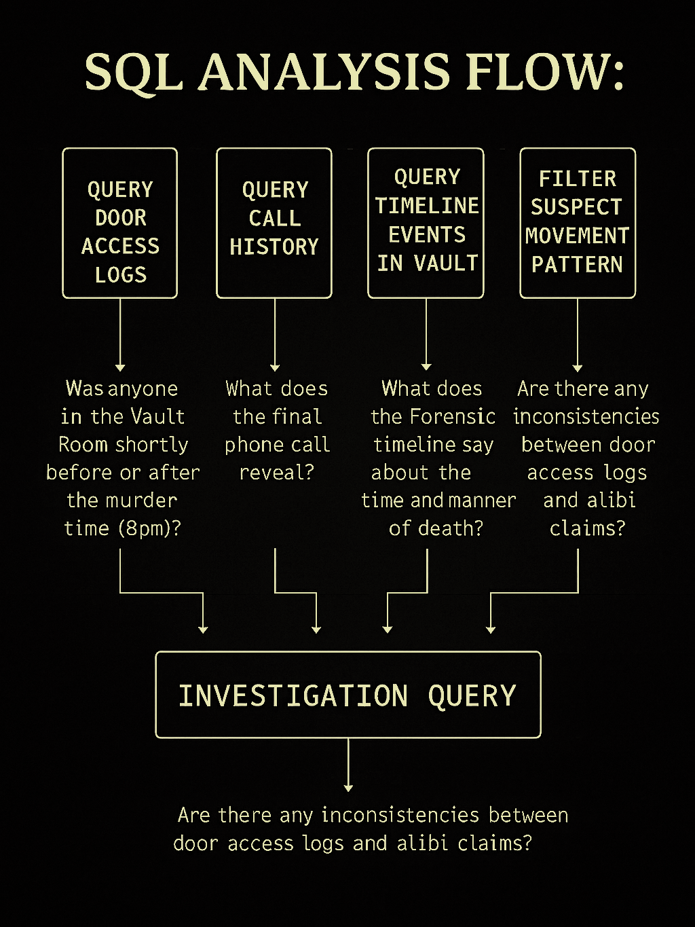

Slide 7
Key Findings
🕒 Vault Room Access
Robin Ahmed entered at 7:56:35 PM (pre-gunshot)
Jamie Bennett entered at 8:00:55 PM (likely discovered body)
Victor Shaw entered at 8:04:53 PM (after security feed cut)
📞 Final Phone Call
Roland spoke to Victor Hale at 7:55:45 PM (1 min)
Then to Susan Knight at 7:56:39 PM (6 min)—she was on the call during the gunshot
🚪 Alibi vs Access Logs
Robin Ahmed’s alibi “Left early” is false
Jamie Bennett’s “At home” is disproven
Victor Shaw’s “At hospital” is contradicted by logs
🧍‍♂️Top Suspects
Robin Ahmed
Jamie Bennett
Victor Shaw

Slide 8


Conclusion
Access Logs: He entered the Vault Room at 7:56:35 PM, just before Roland was last seen alive at 7:57 PM and shot at 8:00 PM.
Alibi Conflict: His alibi—“Left early”—is directly contradicted by the logs. He was inside the Vault Room during the murder window.
Call History: While Robin didn’t place the final call, he was the only person physically present with Roland before the gunshot.
Timeline Overlap: His movement overlaps with the critical forensic events—especially the gunshot and motion detection.
No Verifiable Exit: Unlike Jamie Bennett and Victor Shaw, who entered after the murder, Robin was already inside and unaccounted for during the exact moment of death.

Slide 9
Final Thought
The SQL analysis, forensic timeline, and alibi contradictions converge to spotlight Robin Ahmed as the prime suspect. His presence, timing, and false alibi place him at the heart of the crime.

Slide 10


